Slide 1
E-Commerce and Free Speech Online
ELEG 491

Slide 2
Regulating E-Commerce and Speech: Some Main Questions
Should certain forms of speech and commerce in cyberspace be regulated? If so, which kinds of speech?
(hate speech/inciting physical harm/obscenity)
and what do we regulate in e-commerce?
(products ordered online, ISPs, the content streamed, etc.)

Slide 3
Some complications:
How should forms of Internet speech be regulated, if at all?
Does anonymity/pseudonomity affect our conception of free speech?
What is the “jurisdiction” problem?
If e-commerce is different from the “brick-and-mortar” kind, does this exempt it from regulation?

Slide 4
Two Different Senses of Internet Regulation
To "regulate" typically means to
  monitor or control a certain product, process, or set of behaviors.
Two different senses of online regulation:
regulating content, e.g., online pornography, hate speech, etc.
regulating processes – i.e., rules and policies – for commercial transactions in cyberspace.

Slide 5
Who Regulates Commerce and Speech?
Assuming that cyberspace can be regulated, who should be responsible for carrying out the regulatory functions:
the Federal/state government?
private organizations?
Internet users themselves?

Slide 6
The Internet as a Medium
Four traditional types (“titles”) of media:
(from the Communications Act of 1934)
publishing
broadcast
distribution
common carrier *
    (in 2015, FCC declared Internet a CC, thus subject to the same rules as other utilities; in 2018 this ruling was reversed)

Slide 7
“Common Carriage” goes back to the Interstate Commerce Act of 1887
“The purpose of common carrier law is to ensure that the business being paid to transport [goods/people/data] must do so in a way that is agnostic to the thing being transported. Because railroad companies are common carriers railway ticket sales cannot discriminate against people based on their race, gender, appearance, and/or sexuality. The railroad has to service anyone who wants to ride, and they cannot change their fares on a per passenger basis. Similarly, common carrier freight rail organizations cannot discriminate based on the type of good being shipped.”
See “Network Neutrality: A History of Common Carrier Laws 1884-2018” at https://medium.com/@TebbaVonMathenstien/network-neutrality-a-history-of-common-carrier-laws-1884-2018-2b592f22ed2e

Slide 8
The role of Bell/AT&T
Bell’s patents expired by 1894
Bell consolidated control over long-distance service nationwide by the 1920’s
The 1934 Act declares Bell a “natural monopoly” and places it under common carrier regulation—what they “transported” had to treated with neutrality
AT&T converges with the “baby Bells to continue the monopoly

Slide 9
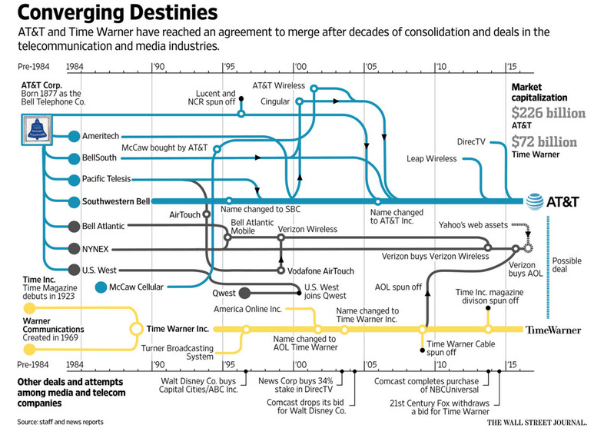

Slide 10
Network Neutrality
What, exactly, is network neutrality, or “net neutrality,” as it is commonly called?
Tim Wu describes it as a principle in which
    “a maximally useful public information network aspires to treat all content, sites, and platforms equally.”

Slide 11
Network Neutrality (Continued)
Comparing the electric grid to the Internet, Wu writes:
    “The general purpose and neutral nature of the electric grid is one of the things that make it extremely useful. The electric grid does not care if you plug in a toaster, an iron, or a computer. Consequently it has survived and supported giant waves of innovation in the appliance market. The electric grid worked for the radios of the 1930s works for the flat screen TVs of the 2000s. For that reason the electric grid is a model of a neutral, innovation-driving network. “

Slide 12
For Discussion:
What good reasons are there for allowing ISPs (and other digital enterprises) to “treat information differently”?
What good reasons are there for not allowing “different treatment”?

Slide 13
Content vs. Process Based Regulatory Agencies in Physical Space
Examples of content-based agencies include:
Food and Drug Administration (FDA);
Local and State Boards of Health;
Liquor Control Board.
Examples of process-based agencies include:
Federal Trade Commission (FTC);
Federal Communications Commission (FCC)
Security and Exchange Commission (SEC).

Slide 14
An Example: Digital Rights Management (DRM) Technology
DRM technologies allow content owners to regulate the flow of information in digital media by blocking access to it via encryption, and limiting access through passwords.
Is this content regulation, process regulation, neither, or both?

Slide 15
DRM and the Music Industry (Continued)
Internationally, France’s National Assembly passed a law (in 2006) that forces distributors of online music in France to remove DRM so that music can be played on any device.
In the U.S., as a result of several lawsuits in the 1990s and early 2000s, DRM is much stronger (in principle)

Slide 16
Internet Domain Names
Originally, one person (Jon Postel), administered the Internet registries. The National Science Foundation (NSF) formerly controlled the licensing of domain names in the 1980s (taking control from DARPA)
ICANN (Internet Corporation of Assigned Names and Numbers) took over the process in 1998; it was seen as more business friendly than NSF.
Now an international board (Governmental Advisory Committee) administers DNS and other protocols. https://gac.icann.org/

Slide 17
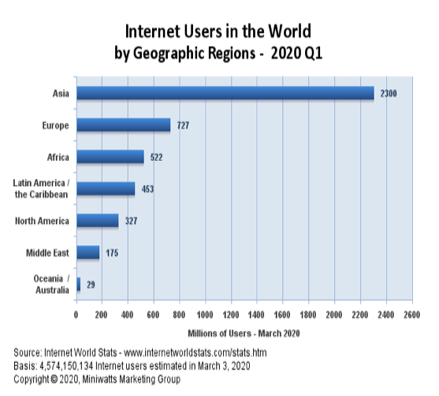
Even if the Internet started in the U.S., what reasons are there for “global” regulation?

Slide 18
Free Speech vs. Censorship in Cyberspace
Should certain forms of speech on the Internet be censored?
Do all forms of speech (in the U.S.) deserve protection under the constitutional guarantee of free speech?

Slide 19
Free Speech (Continued)
According to the First Amendment to the U.S. Constitution,
  “Congress shall make no law...abridging the freedom of speech, or of the press...”
However, the right to free speech is a conditional right (not an absolute right). When can it be suspended?

Slide 20
Non-Protected Speech
Obscenity
Fraud
Incitement (imminent lawless action)
True Threats
Speech as part of criminal conduct
And…the “false fire” exception: Justice Oliver Wendel Holmes Jr.

Slide 21
Pornography in Cyberspace
The concept of pornography is debated in legal spheres in terms of notions such as obscenity and indecent speech.
The Miller v. California case (1973) established that material is obscene when it:
depicts sexual (or excretory) acts whose depiction is specifically prohibited by law.
depicts these acts in a patently offensive manner, appealing to prurient interest as judged by a reasonable person using community standards.
has no serious social, literary, artistic, political, or scientific value. (The SLAPS test)
Indecent speech can be restricted in terms of time, manner, and place.

Slide 22
Internet Pornography and Protecting Children Online
1995: A story entitled CyberPorn in Time Magazine. It found over 900,000 pornographic images online
The study (from CMU) was later shown to be flawed, but it galvanized opposition in Congress to online pornography.
The U.S. courts have generally struck down laws that required all “speech” be made “safe for children.”

Slide 23
USSC rejects most “safe for children” regulation of the Internet
Communications Decency Act (Reno v. ACLU 1997)
Child Online Protection Act (nixed by permanent injunction, 2009)
Children’s Internet Protection Act (federal funding restriction on K-12 schools & libraries, if they don’t implement filters)

Slide 24
Speech That Can Cause Harm to Others
Some forms of hate speech on the Internet are such that they might also result in physical harm being caused to individuals.
On the other hand, harms that are “only psychological” are typically not covered by the law.

Slide 25
John Stuart Mill’s “Harm Principle”
“the sole end for which mankind are warranted, individually or collectively, in interfering with the liberty of action of any of their number, is self-protection. That the only purpose for which power can be rightfully exercised over any member of a civilized community, against his will, is to prevent harm to others….”

Slide 26
“Harm Principle” (cont.)
“…His own good, either physical or moral, is not a sufficient warrant. He cannot rightfully be compelled to do or forbear because it will be better for him to do so, because it will make him happier, because, in the opinion of others, to do so would be wise, or even right... “

Slide 27
Speech That Can Cause Harm to Others
Some examples of how certain forms of speech can result in serious physical harm:
1. information on how to make bombs
2. information on how to abduct children
3. Incitement of “imminent criminal action” or for someone to commit suicide
Should such information be censored on the Internet?

Slide 28

An important aside: how IT can do good things (from MIT Technology Review)

